Slide 1
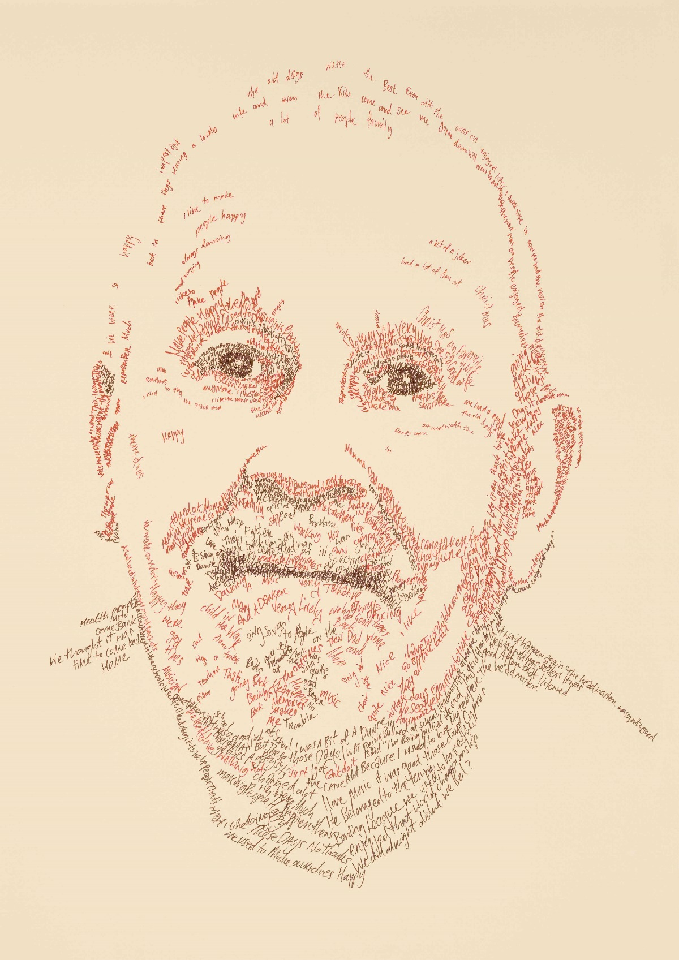
Living with Dementia: Ordinary Lives, Inspirational Voices
Amelia Abbott
aca1g15@soton.ac.uk
Ian

Slide 2
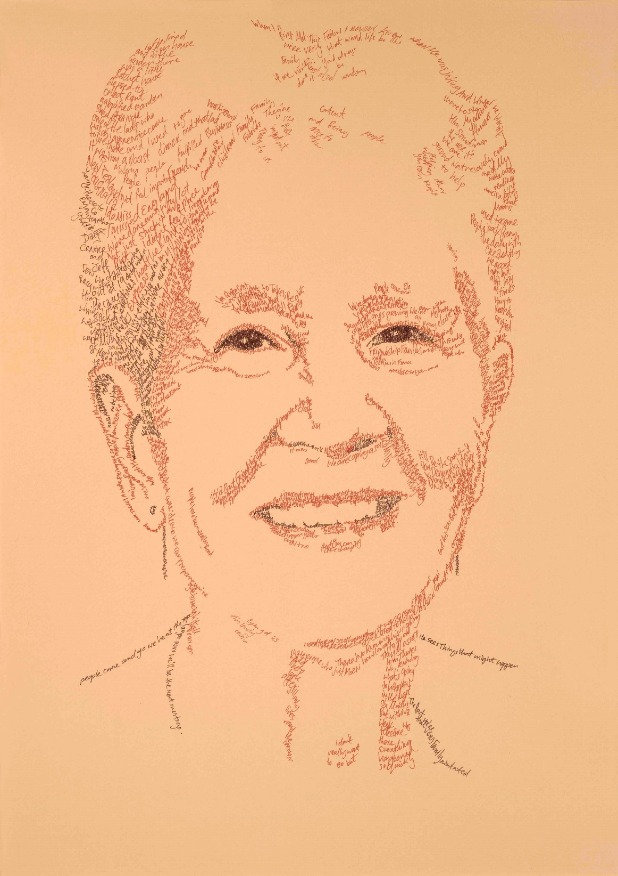
Living with dementia: Ordinary lives, inspirational voices
Presents the ordinary lives and inspirational voices of people with dementia, through the media of biographical portraits and film. Bringing together people with dementia and their families with advocates, researchers and doctoral students from the University of Southampton Alzheimer’s Society funded Doctoral Training Centre, these biographical portraits tell a tale that helps others grasp the impact of dementia on everyday life and on a person’s biography.
Dorothy

Slide 3
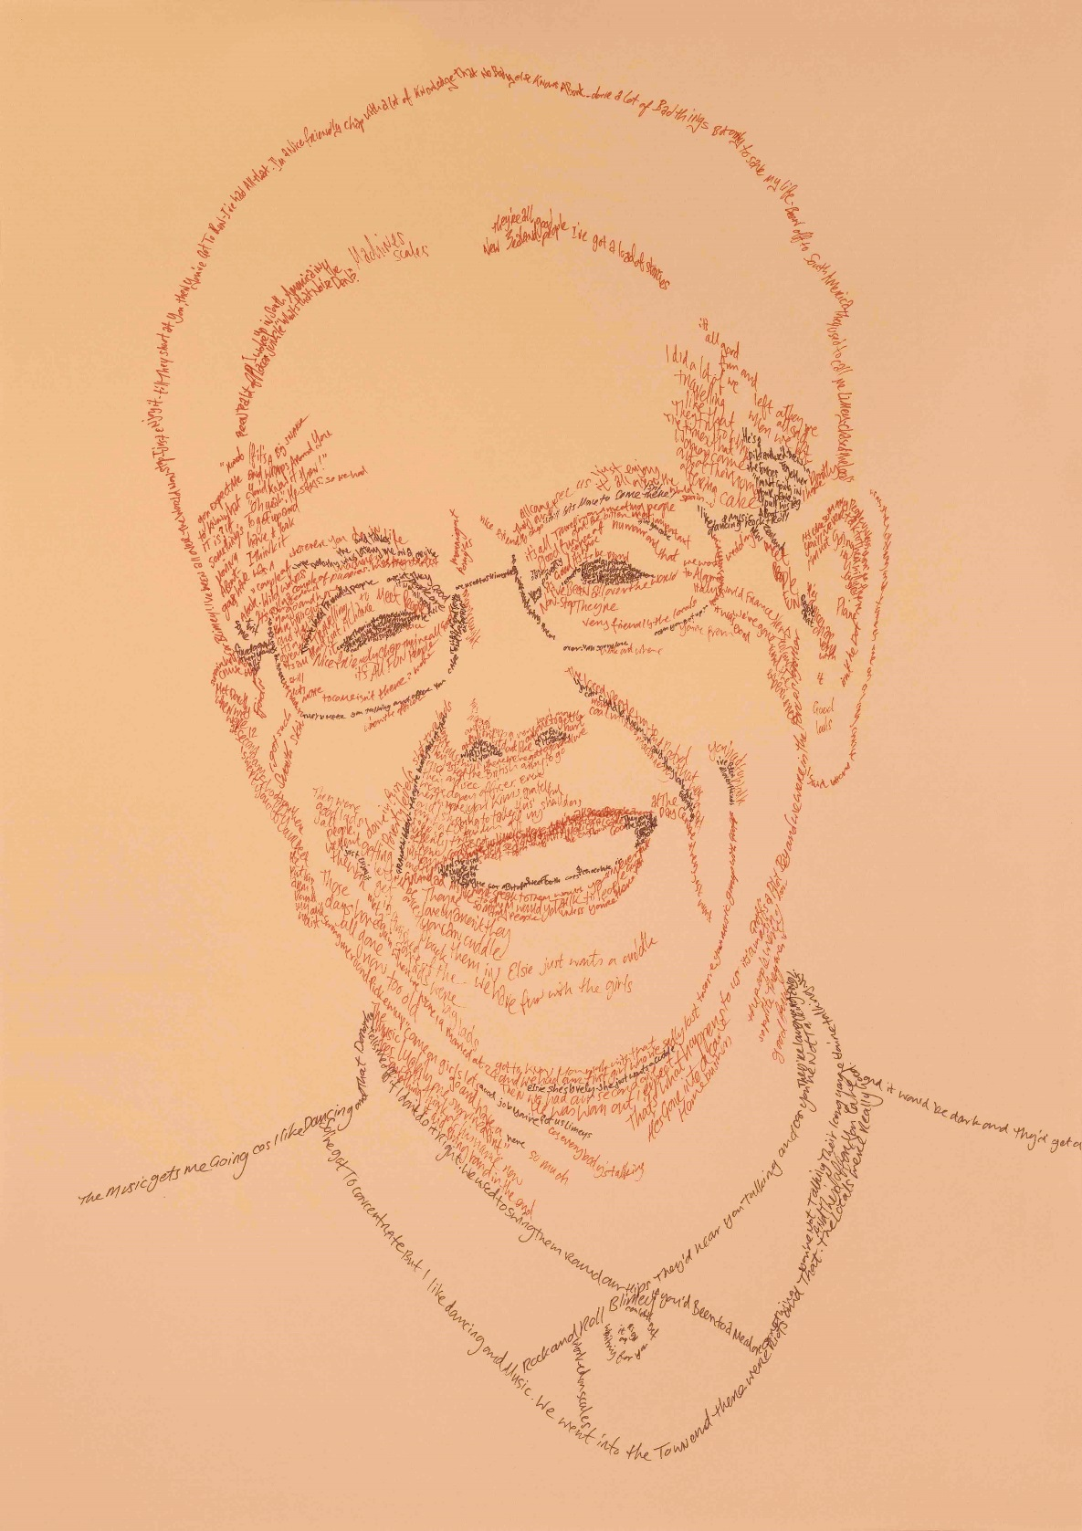
Aims:
Putting the person first – where policies, practitioners and research often consider the dementia over any thing else in the person’s life – the project aimed to invite people living with dementia to talk about their lives and what was or is important to them.
People are interdependent– the project aimed to depict people in the context of their lives with others.
Celebrating lives with dementia - Often with dementia, we focus on the negative assumptions associated with the disease.
Denis
Notes:
The project was led by Tula Brannelly who has worked with people with dementia for a long time.
There were some key focusses of the project.
Putting the person first – where policies, practitioners and research often consider the dementia over any thing else in the person’s life – the project aimed to invite people living with dementia to talk about their lives and what was or is important to them.
People are interdependent – the project aimed to depict people in the context of their lives with others.
Often with dementia, we focus on the negative assumptions associated with the disease. This project wanted to focus on celebrating the lives of people with dementia.

Slide 4
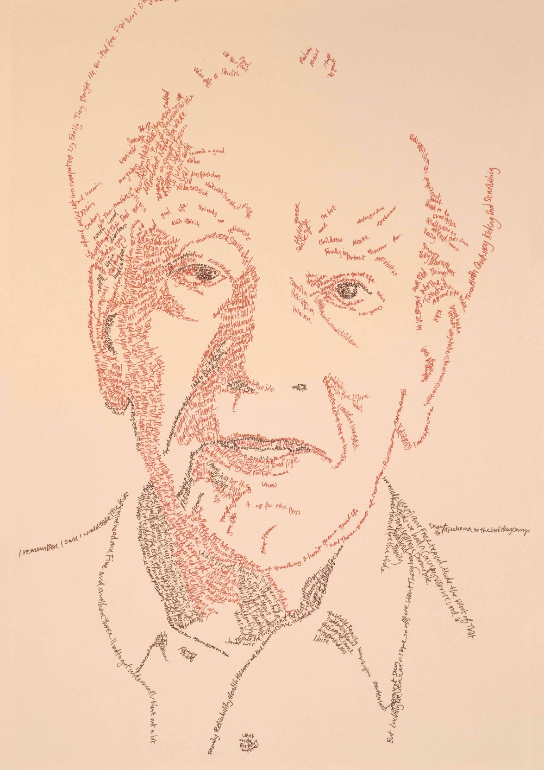
How:
Interviews with members of the Romsey music group
Artist coach – Cathy Garner – created portraits using the words from the interviews to create the lines and details on the portraits
http://theartistcoach.co.uk/
Eddy

Slide 5
Who:
Through Romsey music group, we included 7 participants, all living with dementia in some way
Diagnosed
Family members
Even the music group musician
https://www.youtube.com/watch?v=B7w5hIbxn_w
Search: Andrew Knights – Music Unlocking Memories
Andrew

Slide 6
I have been in dementia research for 6 years. I’ve worked in residential care homes. I’ve volunteered for Romsey music group & Romsey Dementia Action Group. I’ve always worked towards supporting people living with dementia.
Even so, this project really opened my eyes to the power of just sitting and getting to know people with dementia.
“It has been the best thing we could have done”
The husband with dementia moved to residential care, it’s taking a while to settle. But it’s also taking a while for the wife without dementia to settle into her home without her husband. She now has not only a portrait of her husband, but some beautiful quotes; the words he has used to describe his life with her.
Janet

Slide 7
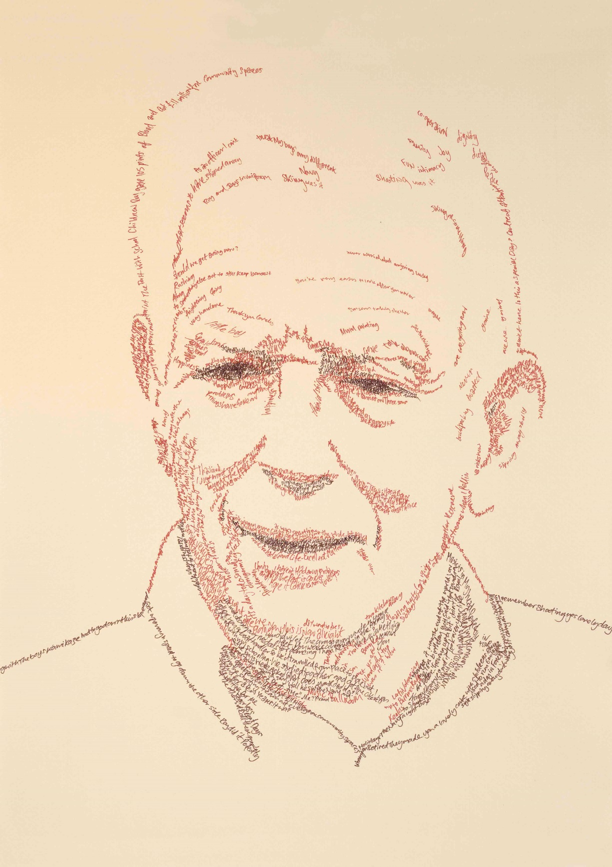
Exhibitions (so far):
Launch, for all participants & their families. Everyone received a copy of their portrait to take home.
Southampton Central Library – 24th July – 29th August
Turner Sims – 9th September – 14th October
Bournemouth University – Dates TBC
If you have any ideas of exhibition spaces, we would love to hear – aca1g15@soton.ac.uk
Roy

Slide 8
Thank you
Public Engagement with Researchers
Alzheimer’s Society – Doctoral Training Centre for Dementia Care
Tula Brannelly – Project lead
Cathy Garner – The Artist Coach
Amelia Abbott
Pippa Collins
Andrew Knights – Romsey music group
And a special thanks to:
Ian, Dorothy, Denis, Eddy, Janet & Roy
https://www.youtube.com/watch?v=7G3U6yrlU-Q
https://generic.wordpress.soton.ac.uk/livingwithdementia
Search for ordinary lives, inspirational voices – our website/blog/video

